Slide 2
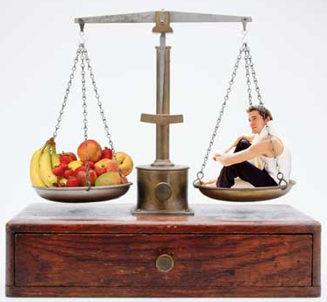
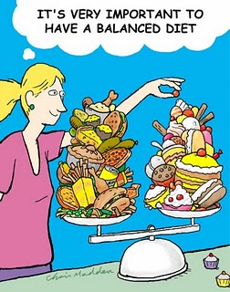
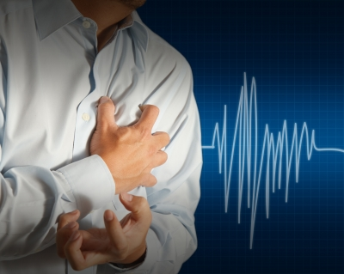
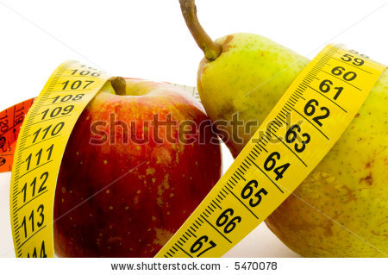
Tuesday 8th January 2014
2.2.1 Diet
Do Now:
Why do we eat?
What is a balanced diet?
What are the components of a balanced diet?
What types of food give you most energy?
What else do you remember from GCSE about diet and health?

Slide 3
2.2.1 Specification
Define the term balanced diet
Explain how consumption of an unbalanced diet can lead to malnutrition, with reference
to obesity
Discuss the possible links between diet and coronary heart disease (CHD)
Discuss the possible effects of a high blood cholesterol level on the heart and circulatory
system, with reference to high-density lipoproteins (HDL) and low-density lipoprotein
(LDL)
Explain that humans depend on plants for food as they are the basis of all food chains.
(No details of food chains are required)
Outline how selective breeding is used to produce crop plants with high yields, disease
resistance and pest resistance
Outline how selective breeding is used to produce domestic animals with high
productivity
Describe how the use of fertilisers and pesticides with plants and the use of antibiotics
with animals can increase food production
Describe the advantages and disadvantages of using microorganisms to make food for
human consumption
Outline how salting, adding sugar, pickling, freezing, heat treatment and irradiation can
be used to prevent food spoilage by microorganisms

Slide 4
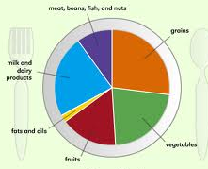
Balanced Diet
Living organisms need vital substances termed nutrients in order to provide energy and materials for growth and repair. Without the regular intake of these nutrients (and oxygen from the air), the organism will suffer ill health and may die
The diet of a person is what is eaten and drunk on a regular basis. The components of a diet can be provided by plants, animals, and microorganisms
Balanced diet A diet which provides an adequate intake of energy and nutrients needed for the maintenance of the body and thus good health
It is the adequate intake of food (mixture of organic and inorganic chemicals) containing the right kinds of nutrients in the right amounts
The Food Standards Agency (FSA) tips for healthy eating
Base meals on starchy foods
Eat lots of fruit and vegetables
Eat more fish
Cut down on saturated (animal) fats
and sugar
Eat less salt
Exercise – maintain a healthy weight
Drink plenty of water
Don’t skip breakfast

Slide 5
There are seven components in a balanced diet
Carbohydrates – source of energy – e.g. glucose; starch
Fats – energy store; cell membranes; insulation (thermal + electrical); protect organs; storage of fat-soluble vitamins; need to ensure consumption of fats containing essential fatty acids
Proteins – growth and repair; enzymes; muscle; antibodies; cell membrane; etc; need to ensure consumption of proteins containing essential amino acids
Vitamins (organic) - Fat soluble - A, D, E, K; water soluble - C, B group – for efficient biochemical function; for coenzymes – required in trace amounts.; K – blood clotting, D – calcium absorption; required in trace amounts
Water – solvent; reactant; transport – variable; about 70% of the body is water
Minerals (inorganic) – structural components and osmotic balance- calcium – for bones, teeth; iron – for haemoglobin;; iodine – for thyroxine (hormone); sodium – for osmotic balance
Fibre (organic) – for efficient peristalsis; prevents constipation; lowers blood cholesterol
Proportions in diet (for energy intake) - 57% CHO; 30% fats; 13% protein
Essential amino acids, essential fatty acids, and vitamins need to be provided in the diet – these cannot be made in the body – others can be made
Needs vary – e.g. age, occupation, pregnancy, lactation, gender, illness

Slide 6
Tasks
Task 1: Describe the function of each food group.
Task 2: List the proportions of each food group we should have in the diet.
Task 3: Adjust the table for mass of each component table for either a pregnant lady or a working adult man, explain the changes you have made.
Task 4: Begin to explain what can happen if we don’t have a balanced diet? What health effects can occur?

Slide 7
Malnutrition (“bad nutrition”)
Malnutrition is caused by insufficient, excessive or an imbalanced consumption of nutrients – this can be due to:
Lack of food – leading to starvation – resulting in a lack of energy and nutrients
  The body adapts by - reducing the metabolic rate, and using stored
  micronutrients (carbohydrates, fats, and proteins)
Protein Energy Malnutrition (lack of carbohydrates and protein) - leads to
kwashiorkor & marasmus
Lack of specific nutrients (unbalanced diet) - leading to deficiency diseases
Iron - iron-deficiency anaemia; vitamin C - scurvy; vitamin D and calcium –
rickets; niacin (vitamin B₃) - pellagra; iodine – goitre; vitamin A – night blindness
Overeating – more energy consumed than used
Excess energy intake leads to obesity (increase in weight)
Obesity is a risk factor in coronary heart disease; hypertension; diabetes;
cancers (bowel, rectum, uterus, cervix); arthritis; hernias; gallstones – mainly due
to a diet rich in carbohydrates and fats and a high concentration of cholesterol in
blood. Excess carbohydrates is converted to fat and stored around vital organs
(e.g. heart & kidneys) and in females underneath the skin
Other causes
Problems with absorption and assimilation (utilisation) of nutrients following
digestion causes deficiency diseases – e.g. celiac disease

Slide 8
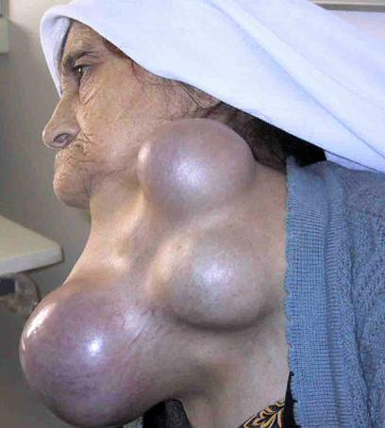
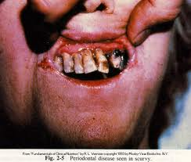
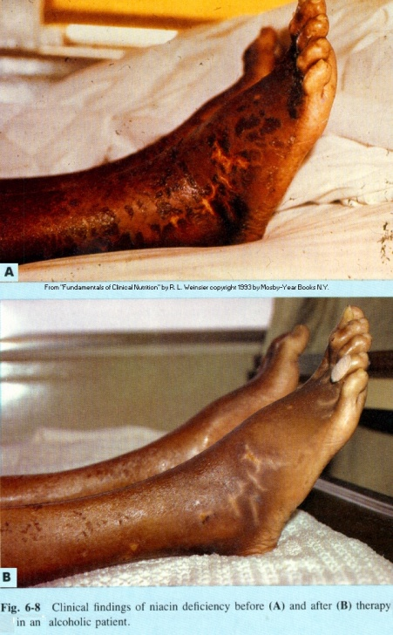
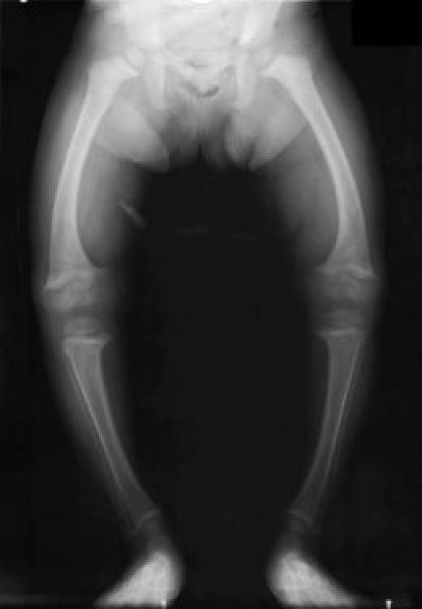
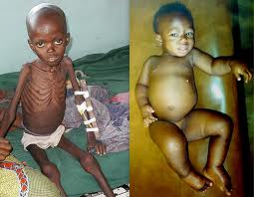
Deficiency diseases
Scurvy – lack of vitamin C
Pellagra – lack of niacin (vitamin B₃)
Goitre – lack of iodine
Pellagra – after niacin therapy
Rickets – lack of vitamin D and / or Ca
Marasmus
– severe nutritional
deficiency
Kwashiorkor
– lack of protein

Slide 9
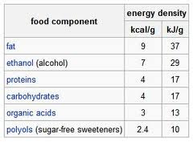
Obesity and Health
Overeating is a form of malnutrition
If the regular intake of energy is in excess of demand, the body gains weight –leading to obesity
  Obesity is an increasing problem in “developed” “Western” countries – associated
  with the diet (rich in fat) and lifestyle (not physically active)
  Fat provides twice as much energy per gram than a gram of carbohydrate or protein,
  due to a higher hydrogen content in the fat molecule – therefore, a fat rich diet
  increases the risk of gaining weight
  Obesity is a growing problem in children – due to consumption of fast foods
  (containing fat, sugars ,and starches) and lack of physical activity
  Obesity is a risk factor in CHD, diabetes, arthritis, and some forms of cancer
A BMI greater than 30 is classified as obese – obesity is a result of
  Eating too much
  High fat, sugar, carbohydrate, alcohol in the diet
  Energy intake greater than use
  Insufficient exercise
  Genetic predisposition
  Underactive thyroid (low basal metabolic rate)

Slide 10
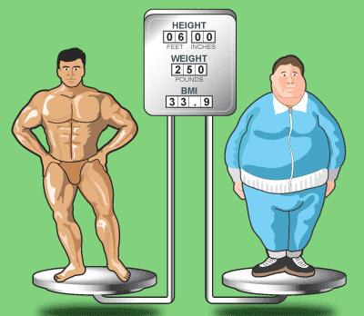
Body Mass Index (BMI) and Obesity
The BMI is used to determine if an adult person is underweight, overweight, or obese
It is calculated using the following formula
mass
BMI =
Height² (m²)
A graph can be used to determine the BMI of a person – however:
  If values fall on a line dividing the categories, it is difficult to place in a category
Limitations of BMI
Difficult to calculate BMI for children and
adolescents – since they store fat as part of their
growth
Does not take into account gender, age, disease
(e.g. osteoporosis; thyroid disease) and other
factors contributing to obesity (e.g. lack of
exercise / pregnancy)
Does not take into account muscle mass / bone
mass, or amount of body fat

Slide 11
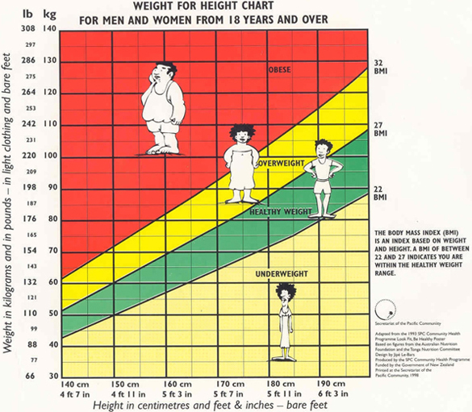
Example
Height = 1.73 m
Mass = 75 kg
BMI = 75 / 1.73²
75 / 2.9929 = 25
BMI = 25
Acceptable
A body weight, 20% in excess of the recommended weight for a particular age is considered obese
X

Slide 12
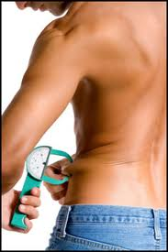
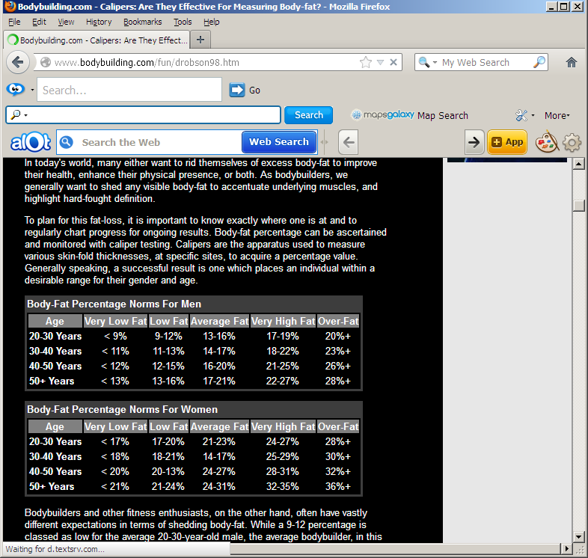
BMI vs. Body-fat percentage measurement
In September 2000, the American Journal of Clinical Nutrition published a study showing that body-fat percentage may be a better measure of a persons risk of weight-related diseases than BMI.
"Many studies have related BMI to disease risk,“ "What we did was correlate body-fat percentage to BMI, allowing us to take the first big step toward linking body-fat percentage to disease risk.
BMI is a broad, general measure of risk. Body-fat assessment is much more specific to the actual fat content and thus provides a more accurate picture.”
"In terms of ease-of-use and usefulness, the BMI can't be beat,“
"But if a home, fat-measurement device helps someone stay focused on their diet and exercise level and motivated to stay healthy, then the device has a place in weight management."

Slide 13
Obesity – a risk factor in a number of diseases
Coronary heart disease - a diet rich in saturated (animal) fats, leads to a high concentration of blood cholesterol.
A high blood concentration of cholesterol and a high blood pressure (hypertension) increases the risk of developing coronary heart disease – e.g.
Atherosclerosis – build up of fatty material (plaques) in coronary arteries
Coronary thrombosis – blood clotting in coronary arteries
Heart attack
Stroke - loss of brain function due to insufficient supply of blood (oxygen and nutrients) due to a blood clot
  Myocardial infarction
Diabetes (type 2) – obese people cannot control their blood glucose , principally due to insensitive insulin receptors
Cancers – colon, rectal, cervical, prostate, uterine, breast
Osteoarthritis (inflammation of the joints) – due to increased strain on the skeleton and joints
Thrombosis – blood clotting in blood vessels of the pulmonary and systemic circulation
Hernias, varicose veins and gallstones
Organ strain – due to organs (e.g. heart, kidneys) being surrounded by excess fat – causes physical strain
Surgery – operations carry an increased risk of complications in obese people

Slide 14
Task 5:
Read the growing problem on page 153.
What could this problem lead to in the long term? (Think socially, economically and ethically.)
In their shoes:
Imagine your were the MP for Health in the UK. What can be done/ implemented to reduce this growing problem?

Slide 15
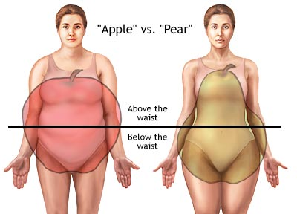
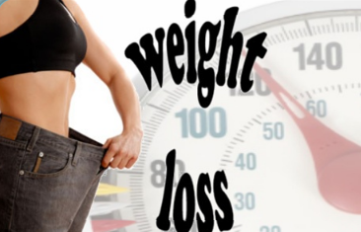
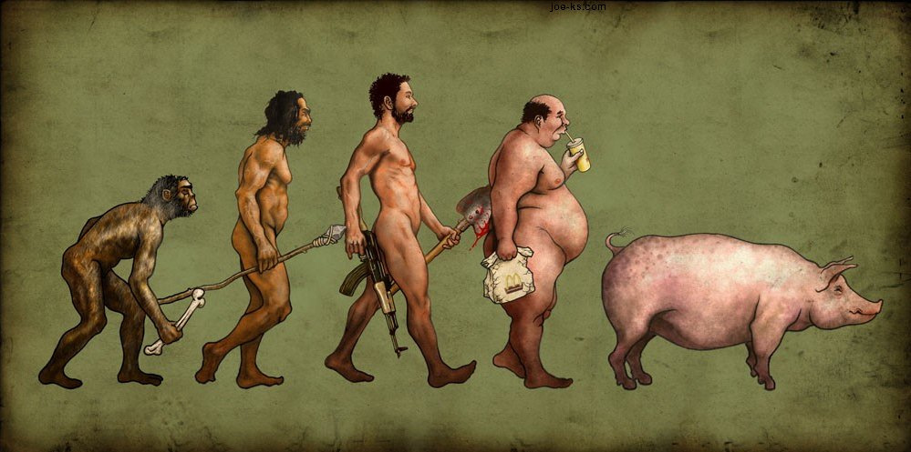
The location of where the fat is deposited has an effect on the acquired conditions
“few moments on the lips, forever on the hips”
  Apple shaped – fat around the middle
  Higher risk of obesity-related conditions
  Pear shaped – fat around hips and thighs
  Lower risk of obesity-related diseases
Preventive measures
Incentives (inducements) to lose weight – e.g.
prizes, competitions
Clubs /local meetings / help lines
Target setting for weight reduction / target groups of
people
Change diet (reducing energy foods and fats)
Reduced alcohol intake
Encourage exercise
Advertising / education
Early education to encourage healthy eating
habits and exercise

Slide 16
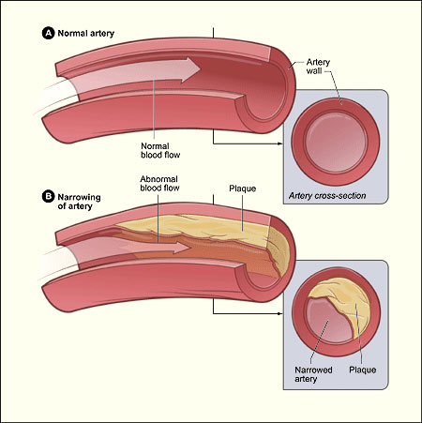
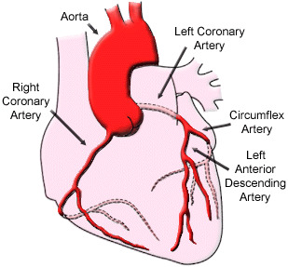
Monday 13th January 2014
2.2.2 Coronary Heart Disease
Do Now:
Past exam question on Diet and Health.

Slide 17
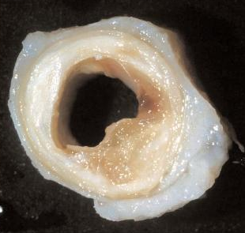
Diet and Coronary Heart Disease (CHD)
A healthy BMI is maintained by balancing the overall energy intake with energy use – to avoid becoming underweight or overweight (obese).
Excess intake of certain components in the diet may increase the risk of CHD – a major cause of death in developed countries.

Slide 18
Diet and Coronary Heart Disease (CHD)
CHD is a result of reduced blood flow to the heart – leading to angina, myocardial infarction and heart failure, caused by the narrowing and hardening of coronary arteries – the blood vessels supplying the heart
Deposition of fatty material in the walls of the coronary arteries leads to a narrowing of the lumen – thus restricting blood flow to the heart muscle, which may cause oxygen starvation .
Energy is not produced and the cardiac fails to contract – lack of oxygen causes the cardiac muscle to die
Arteriosclerosis (hardening of the arteries) also occurs – reducing their elasticity and therefore their ability to expand and recoil – the heart has to work harder to force blood through the coronary arteries and may cause the blood pressure to rise and heart muscle to fatigue

Slide 19
Three forms of CHD
Coronary arteries
Narrow arteries that carry oxygenated blood from the aorta to cardiac muscle at high
pressure
Increased risk of damage due to narrow lumen – further narrowed by deposition of plaque
(fatty material) – thus reducing blood flow to cardiac muscle
Reduces supply of oxygen (and glucose) for respiration. Leads to CHD – three forms:
  Angina pectoris
  Severe chest pain on exertion due to restricted blood flow to cardiac muscle; no death
  of heart tissue
  Heart attack (myocardial infarction)
  Coronary artery becomes obstructed by a blood clot (thrombus) – heart muscle is
  starved of oxygen – dies – causes sudden and severe chest pain - may be fatal if not
  treated immediately
  Heart failure
  Due to blockage of a main coronary artery and gradual damage to heart muscle; heart
  weakens and fails to pump effectively
  Thrombosis
  A blood clot (thrombus) may form at the site of the atheroma – may block
  coronary artery – leading to myocardial infarction
  Stroke
  Sudden symptoms - bursting of artery in brain (brain haemorrhage); blockage
  of brain artery due to atherosclerosis or thrombus – reduces oxygen for
  respiration; causes cerebral infarction; fatal or disabling

Slide 20
CHD is multifactorial – it has many risk factors
High intake of saturated fats - a cholesterol level greater than 250 mg/100 cm³ (5.2
mmol per dm³) of blood – cholesterol is present in fats and is also made from saturated fats
High salt intake; smoking; heredity (familial hypercholesterolemia)
Lack of exercise; overweight; obesity
Diet low in unsaturated fats; diet low in fibre; lack of vitamin D; lack of antioxidants (vitamins
A, C, and E)
Alcohol; stress; age; gender; diabetes; poverty
Obesity – causes an increase in blood pressure, causing the heart to work much harder and increasing the pressure on artery walls – promotes deposition of cholesterol
Salt – excess salt in the blood decreases the water potential of blood, causing water to enter blood vessels by osmosis and increasing the blood pressure – leading to hypertension – damaging the internal lining of the coronary arteries – an early step in atherosclerosis

Slide 21
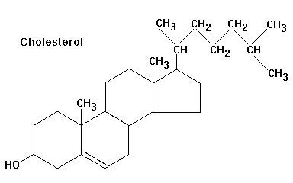
Cholesterol is a derived lipid and is insoluble in water. It is essential for
  Vitamin D synthesis in the skin
  Cell membrane component (regulates fluidity)
  Synthesis of steroid hormones (sex hormones; adrenal cortex hormones)
  Formation of bile salts
It is mainly found associated with saturated fats in meat, eggs and dairy products. It is also made in the liver from saturated fats
Being insoluble in water (plasma), it is transported in the blood in structures called high density lipoproteins (HDLs) and low density lipoproteins (LDLs)

Slide 22

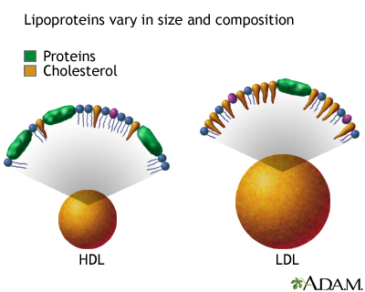
Lipoproteins and CHD
LDLs (mainly lipid) – “bad”
Composed of - saturated fats + much cholesterol + little protein
A diet high in saturated fats raises LDL levels - increase blood
cholesterol – increase risk of CHD
Transport cholesterol from the liver to tissues via blood
Tend to deposit cholesterol at damaged sites in endothelium of artery
walls. LDL’s are referred to as “bad lipoproteins”
Saturated fats reduce activity of LDL receptors in tissues – therefore,
less cholesterol is removed from blood – deposited in artery walls to
form atheromas
Unsaturated fats increase activity of LDL receptors – decrease LDLs in
blood
HDLs (mainly protein) – “good”
Composed of unsaturated fats + less cholesterol + much protein
A diet high in unsaturated fats raises the HDL levels - reduce blood
cholesterol – reduce risk of CHD – “good lipoproteins”
Transport cholesterol from the tissues to the liver to be excreted in bile
(or recycled); help to protect arteries against atherosclerosis
Reduce blood cholesterol; reduce arterial deposition; and help to remove
fatty deposits - decrease the formation and risk of atheromas
Liver cells have HDL receptors

Slide 23
Diet, Lipoproteins and CHD
A diet high in saturated fat and cholesterol increases blood cholesterol levels – increase s concentrations of LDLs and lowers concentrations of HDLs– more cholesterol is transported in the blood , from the liver to tissues – increases risk of CHD
A low saturated fat diet reduces the overall concentration of lipoproteins
A diet rich in unsaturated fats increases the proportions of HDLs and lowers LDLs in blood – more cholesterol is transported to the liver from tissues – reduces risk of CHD
Eating monounsaturated and polyunsaturated fats helps to reduce the concentration of LDLs in the blood
Cholesterol is derived from many sources – animal fats; eggs; milk; butter
Ratio of HDL to LDL is important
  a high blood (plasma) concentration of HDLs reduces the deposition of cholesterol in artery walls
  a high blood (plasma) concentration of LDLs increases the deposition of cholesterol in artery walls
Only a small amount of free cholesterol escapes from LDLs under normal conditions.
A high amount of cholesterol in the LDLs causes increased leakage of cholesterol into the
plasma
Cholesterol is deposited at the site of damage in arterial walls arterial walls – forming fatty
streaks – leading to the development of plaques (atheroma)
An atheroma increases the risk of blood clotting in arteries.
Deposits may start to build up from childhood

Slide 24
Atherosclerosis
The main process leading to cardiovascular disease is the accumulation of fatty material (plaque) in artery walls – mainly aorta, coronary arteries, and carotid artery) , narrowing their lumen and thus restricting blood flow to tissues and cardiac muscle
Arteries also become hardened and lose their elasticity – termed arteriosclerosis.
The fatty material may increase the risk of blood clots , obstructing the flow altogether.
Tissue does nor receive enough O₂ and nutrients and may die.
Plaque – formed due to build up of fatty material (atheroma) under endothelium in artery wall – consists of cholesterol, fibres, dead, muscle cells, platelets, and foam cells (phagocytes with ingested fat).
Damage (break) in artery wall encourages atheroma formation – damage may be due to hypertension, or carbon monoxide and nicotine from smoking
Deposited material originates in plasma
Deposits may start to build up from childhood
Plaques in the lining of arteries, make the arteries less elastic and restrict blood flow
The condition is called atherosclerosis
An atheroma increases the risk of blood clotting – the clot may break off and lodge in coronary arteries – causing myocardial infarction (tissue death)

Slide 25
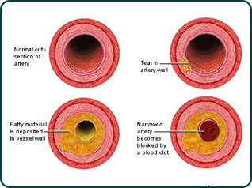
Artery lining (the endothelium) gets damaged – e.g. by CO; nicotine; high blood pressure
Phagocytes are attracted to damaged site through chemotaxis – to repair damage
LDLs accumulate in the inner coat (smooth muscle) of arteries – under the endothelium at the site of damage (break) as small fatty streaks
White blood cells ingest fats and become foam cells and sink into the lesion
Increase in the growth of smooth muscle and build up of connective tissue around damaged site occurs – causes fibrosis and hardening - causes loss of elasticity (arteriosclerosis) of artery wall – causes an increase in BP
Free radicals released from the phagocytes react with the cholesterol
Fatty material (cholesterol from LDLs), dead muscle cells and platelets are deposited – known as plaque (developing into an atheroma); high blood pressure also increases deposition of LDLs
Artery wall bulges into lumen – causes narrowing and restricts blood flow
Platelets may be activated – release thromboplastin and a. Blood clot may form (leading to ischemia (reduced blood flow); angina and myocardial infarction (death of cardiac muscle)
Normally, anticlotting factors (e.g. heparin in blood) prevent clotting

Slide 26
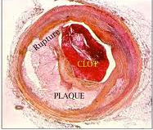
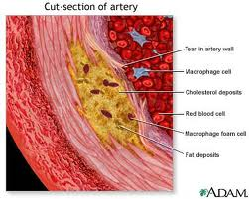
The endothelium covering a plaque may rupture - to cause the formation of a blood clot (thrombus)
Tear in artery wall
Macrophage cell
Cholesterol deposits
Red blood cell (in lumen)
Macrophage foam cell
Fat deposits

Slide 27
Evidence Linking CHD to Diet
Risk factors in CHD have been identified through long-term epidemiological studies
Whitehall Study - with large groups of people – based on lifestyle, illnesses, and cause of death
Common factors - identified: Hypertension
High cholesterol levels in blood
Smoking
Diabetes
Exercise – reduced incidence of CHD
MONICA (1979) – WHO – study of global distribution of CHD
Identified a correlation with blood pressure and blood cholesterol as key
factors in predicting the likelihood of CHD developing in a person
Found higher levels of vitamin E (antioxidant ) in people from countries with low rates of heart disease
High incidence of CHD in Finland – linked to a diet rich in animal fats
Lowest rate of CHD in Spain and Italy – linked to a high intake of unsaturated fats – which tends to lower blood cholesterol levels, so long as saturated fat intake is low. But – France has lowest rates of CHD, although the intake of animal fats is
high – suggests that saturate fat and cholesterol intake alone are not important
Other dietary factors may be important (e.g. salt intake)

Slide 28
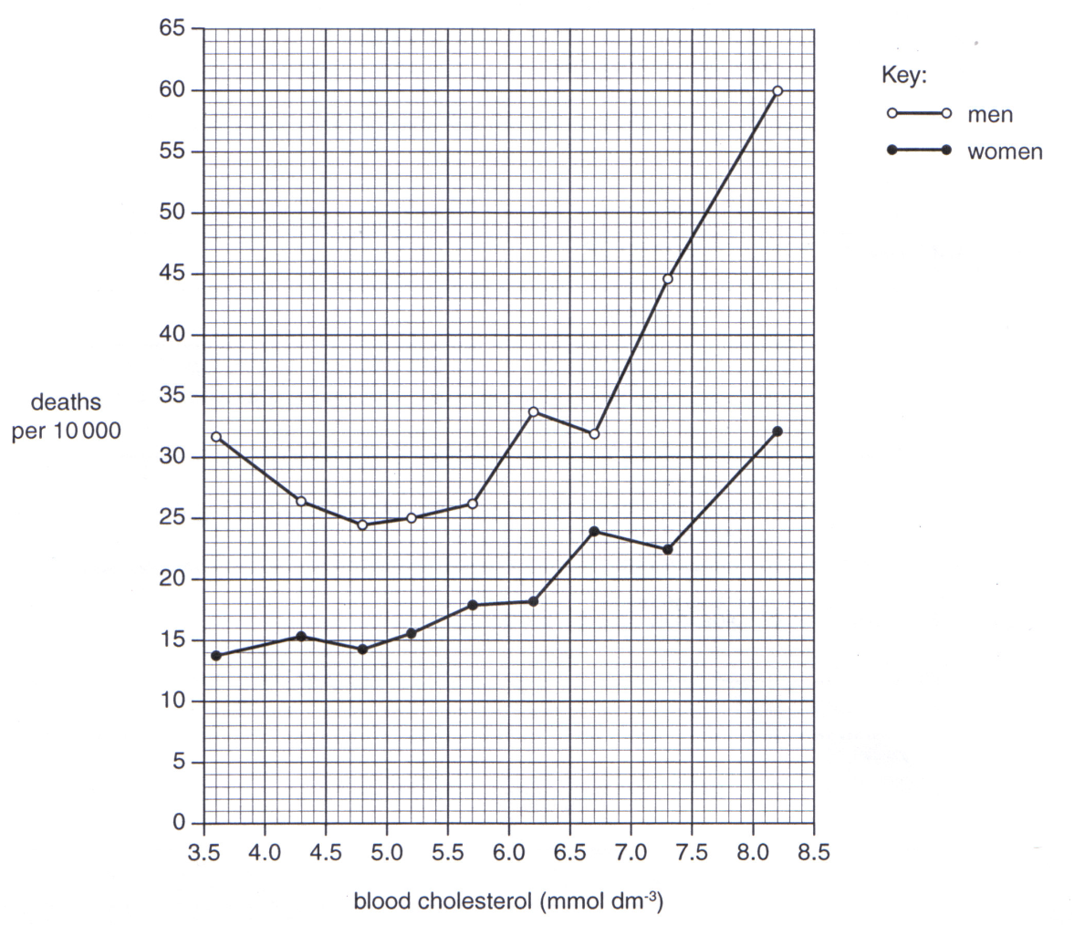
Exam Question & Marking Scheme
Human populations with diets high in animal fats have a lower life expectancy than those with
diets high in vegetable oils
Suggest one difference between lipids from
animals and those from plants
Animal fats are thought to raise blood
cholesterol levels. High blood cholesterol
can lead to premature death
The Figure shows the relationship between blood cholesterol level and annual death rate per 10 000 of the population
Describe the trends shown in the Figure
Increased blood cholesterol levels are associated with certain medical conditions
Suggest two medical conditions that may be associated with increased blood cholesterol levels
Animal fats are saturated
Fatty acids have no / fewer, double bonds
Animal fats are solids at room temperature
Death rates for men greater at any concentration

