Slide 2
Monday 10th March 2014 Immunity
Module 2: Food and Health
Health and Disease

Slide 3
Learning Outcomes
Define the terms immune response, antigen and antibody.
Describe the primary defences against pathogens and parasites (including skin and mucous membranes) and outline their importance.
Describe, with the aid of diagrams and photographs, the structure and mode of action of phagocytes.

Slide 4
Definitions
Immune response
Specific response to a pathogen
Involves the action of lymphocytes and the production of antibodies
Antibodies
Protein molecules produced and released in response to a antigen
Antigen
Foreign molecule – protein or glycoprotein
Provokes an immune response

Slide 5
Primary Defences
The body’s primary defences attempt to stop pathogens from entering body tissues
This includes
The skin (epidermis)
Mucous membranes
Eyes protected with tears
Ear canal lined with wax

Slide 6
Epidermis
The outer layer of the epidermis is a layer of dead cells which contain the fibrous protein keratin.
These cells are produced in the process keratinisation – the cells dry out and the cytoplasm is replaced with keratin.
This layer of cells acts as a barrier

Slide 7
Mucous membranes
Mucous membranes protect surfaces which are at risk of infection
Mucus is secreted by the epithelial linings of airways, digestive system and reproductive systems
In the airways ciliated cells move mucus up to the mouths where it can be swallowed
In the stomach, hydrochloric acid kills most pathogens that we ingest.

Slide 8
Secondary Defences
Non-specific immune response
Phagocytes
Specific Immune response
B and T lymphocytes
Antibody production

Slide 9
Phagocytosis
Phagocytes engulf and digest pathogenic cells
Neutrophils
found in the blood and body tissues
Collect at an area of infection
Macrophages
Travel in blood as monocytes
settle into the lymph nodes where they develop
Stimulates production of T lymphocytes

Slide 10
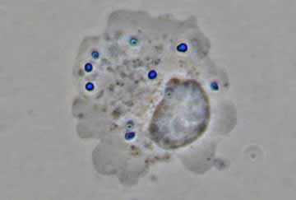
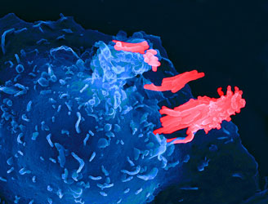
Phagocyte - photographs
Neutrophil
Macrophage
Macrophage engulfing tuberculosis bacterium

Slide 11
Stages in phagocytosis
Pathogens are recognised by antigens on their surface
Phagocyte moves towards pathogen and receptors on the cell surface membrane attach to antigens on the pathogen
Phagocyte engulfs the pathogen creating a phagosome
Lysosomes fuse with the phagosome releasing digestive enzymes
End products absorbed into the cytoplasm.

Slide 12
Phagocytosis Animations
http://www.microbelibrary.org/images/tterry/anim/phago053.html

Slide 13
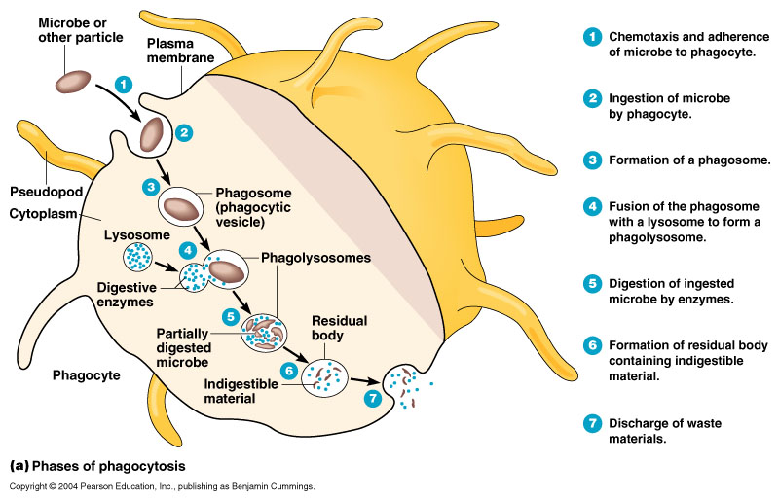
Stages of Phagocytosis

Slide 14
Learning Outcomes
Describe the structure and mode of action of T lymphocytes and B lymphocytes, including the significance of cell signalling and the role of memory cells.
Describe, with the aid of diagrams, the structure of antibodies.
Outline the mode of action of antibodies, with reference to the neutralisation and agglutination of pathogens.

Slide 15
Specific Immune response
Teacher Fault : Bind antibody/pathogen and agglutination engulfed

Slide 16
Specific Immune response
Teacher Fault : Bind antibody/pathogen and agglutination engulfed

Slide 17
Immune Response
Immune response is the activation of lymphocytes in the blood to help fight disease
T- Lymphocytes
Produced in bone marrow
Mature in the Thymus
B-Lymphocytes
Produced and matures in bone marrow

Slide 18
Immune response
Pathogen enters body
Clonal selection
Antigens bind to complementary glycoproteins on B and T lymphocytes
This stimulate the immune response
Clonal expansion
B and T lymphocytes divide by mitosis

Slide 19
T-lymphocytes
T lymphocytes divide into 3 types of cell
T helper cells (T_{h})
Release cytokines
stimulate B cells to develop
Stimulate phagocytosis (cell signalling)
T killer cells (T_{k})
Attack and kill infected body cells
T memory cells (T_{m})

Slide 20
B lymphocytes
B lymphocytes develop into two types of cell
Plasma cells (P)
Flow in blood
Manufacture and release antibodies
B memory cells (B_{m})
Immunological memory
Remain in blood for a number of years
Stimulate the production of plasma cells quickly upon reinfection by same pathogen.

Slide 21
Cell signalling in immune response
Identification of pathogens
Sending distress signals
Antigen presentation
Instructions
Communication using cytokines

Slide 22
Stages in immune response
Infection and reproduction of pathogen
Presentation of antigens
Clonal selection
Clonal expansion
Differentiation (proliferation)
Action – antibody production

Slide 23
Antibodies
Proteins a.k.a. immunoglobulins
Specific shape complementary to that of an antigen
Antibody shape
4 polypeptide chains held together by disulphide bridges
Variable region
2 binding sites specific to an antigen
Hinge regions allow flexibility

Slide 24
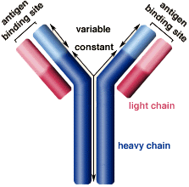
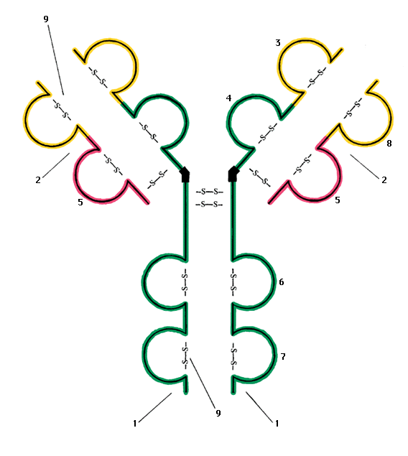
Antibody structure

Slide 25
Mode of action of antibodies
Neutralisation
Antibodies bind to toxins neutralising their effects
Antibodies combine to viruses and prevent them from entering the cell.
Agglutination
Pathogen clump together
Too large to enter host cells
Helps phagocyte to engulf and digest pathogens

Slide 26
Learning outcome
Compare and contrast the primary and secondary immune responses.

Slide 27
Primary Immune response
Production of plasma cells
Antibodies produced to combat infection
Takes a few days for number of anti-bodies in blood to rise

Slide 28
Secondary immune response
B memory cells circulate in blood
Rapidly produce plasma cells upon reinfection
Plasma cells produce antibodies
Rapid response

Slide 29
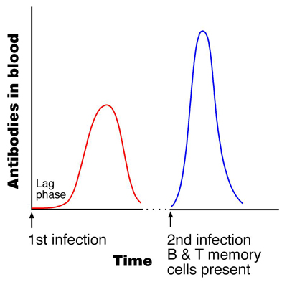
Primary and secondary immune response

Slide 30
Learning Outcomes
Compare and contrast active, passive, natural and artificial immunity.
Explain how vaccination can control disease.
Discuss the responses of governments and other organisations to the threat of new strains of influenza each year

Slide 31
Monday 17th March 2014 Vaccination

Slide 34
Immunity
Natural immunity
gained as part of normal life processes
Artificial immunity
Gained by deliberate exposure to antibodies or antigens
Active immunity
Results from stimulation of immune response
Passive immunity
Introduction of antibodies
Short lived

Slide 35
Immunity
Immunity | Active | Passive
Natural | Long term immunity Infected by the disease inducing an immune response Takes time | Immediate protection Antibodies from mother Across placenta In colostrum (breast milk) Short term immunity
Artificial | Long term immunity Immunisation or vaccination Takes time | Immediate protection Injected with antibodies e.g. tetanus injections Short term immunity

Slide 36
Vaccination
Vaccine
Preparation of antigen
Injected or given by mouth
Stimulates primary immune response
Boosters given to stimulate secondary immune response

Slide 37
Antigenic material
Living attenuated micro-organisms
Can not cause symptoms
Multiply
E.g. TB, poliomyelitis
Dead micro-organisms
Harmless but induce immunity
E.g. typhoid, cholera
Preparation of antigens
E.g. hepatitis B vaccine
Harmless toxin
E.g. tetanus vaccine

Slide 38
Control of disease
Vaccinations can be used to control disease by providing immunity to all those at risk
Herd immunity
Use a vaccine to provide immunity to all of the population at risk
Ring immunity
Vaccinate everyone in surrounding area to prevent transmission of disease

Slide 39
Influenza
Viral disease of the respiratory system
Associated with
Fever
Sore throat
Headache
Muscle pains
Weakness
Can lead to pneumonia
Can be fatal
New strains arise by mutations (some virulent)

Slide 40
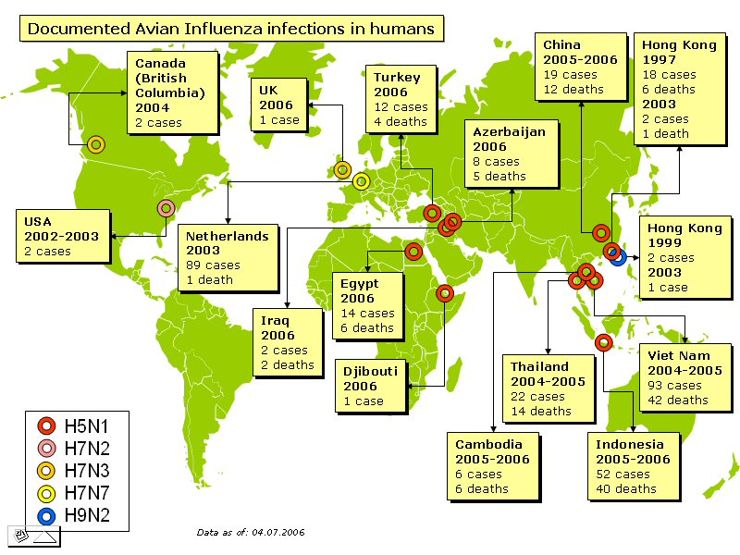

Slide 41
vaccination programmes
Epidemic
Disease suddenly spreads rapidly to infect many people
Pandemic
Large scale outbreak of a disease
Governments research and try to predict which strains of flu are going to appear each year

Slide 42
Vaccination programmes in UK
All people aged over 65
Young people with asthma
People who work in high-risk categories such as medical professionals
The strains of flu used in the immunisation programme change each year.

Slide 43
Learning Outcomes
Outline possible new sources of medicines, with reference to microorganisms and plants and the need to maintain biodiversity.

Slide 44
New Medicines
Why do we need new medicines
Pathogens become resistant to existing drugs e.g. antibiotics
New disease emerge
New vaccines needed e.g. HIV
Existing vaccines can be improved

Slide 45
Discovery of New Medicines
By accident
E.g. Alexander Fleming and the discovery of penicillin
Traditional medicine
Anaesthetics
Observation of wildlife
Modern research

Slide 46
Natural medicines
Discovery of natural drugs has concentrated on tropical plants due to the great diversity of species in tropical rainforests
Examples
Madagascan periwinkle – anticancer
Sweet wormwood – antimalarial
It is important that plant species do not become extinct before we can discover their value.

