Slide 1
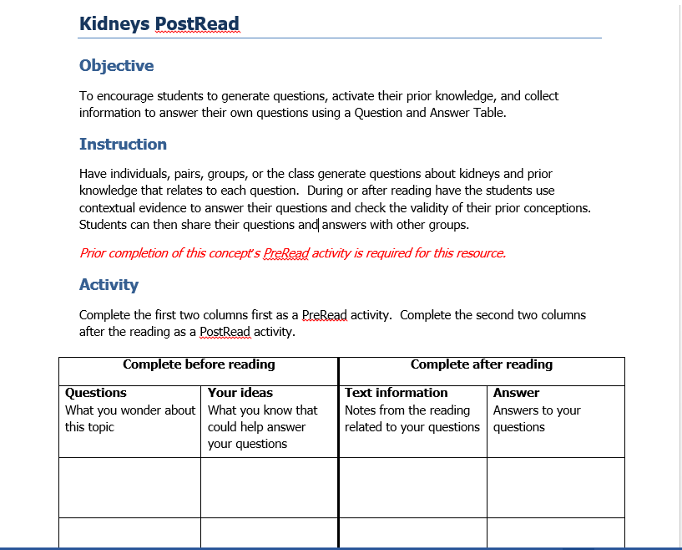
Encouraging pre/ post reading with clear outcomes

Slide 2
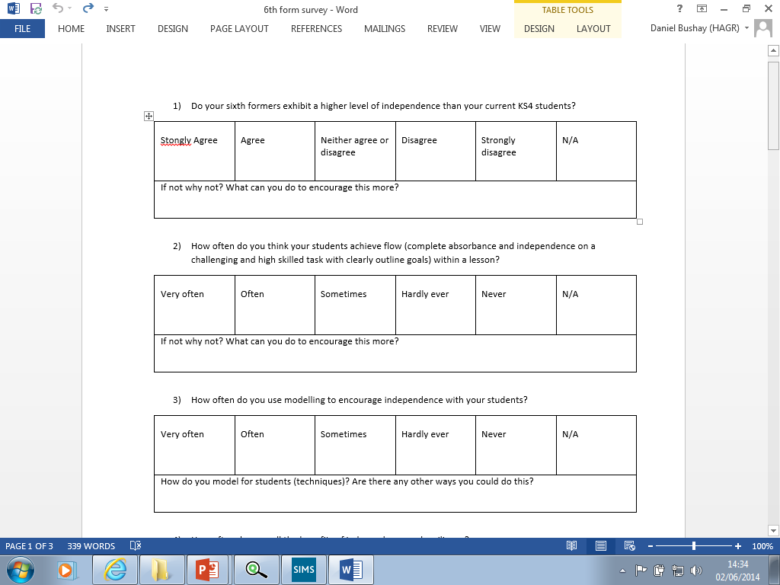
Kidneys can’t be that important as people can survive with just one.
Strongly Agree
Drinking too much water can be negative.
Strongly Agree
Kidneys are one of the top 3 most important organs in your body.
Strongly Agree

Slide 3
Wednesday 4th June 2014
The Kidneys
By the end of the lesson I should be able to …
Draw and label a tissue plan of kidneys
Describe how the kidneys filter the blood
Explain how the composition of fluid changes

Slide 4
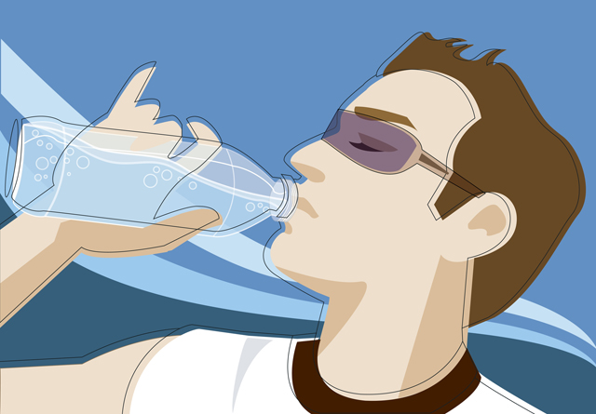
What do the kidneys do?
The kidney has two important functions
  Osmoregulation – controlling water and ion levels in the body
  Excretion – the removal of waste substances from the blood.

Slide 5
Excretion
Excretion is the removal of waste products of metabolism from the body.
The main organs for excretion are:
  The kidney – through which urine is excreted
  The skin- which excretes salts and sweat
  The lungs – which excrete water vapour and carbon dioxide.
Elimination (egestion) is the removal of waste products which have not been involved in metabolism e.g. fibre. Egestion is different from excretion.

Slide 6
Importance of excretion
It is essential as it removes toxic (poisonous) wastes from the body. If these chemicals were allowed to build up they would slow down and eventually stop important chemical reactions in the body.
Carbon dioxide is a waste product of respiration a build up of CO2 in the body results in an increase in blood acidity, breathing would become more frequent and deeper, eventually you would fall unconscious and may die.
So removal of waste products is really important!

Slide 7
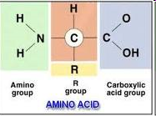
Urea
The body can not store proteins or amino acids, so excess is broken down.
This involves the removal of the amino (NH2) group is removed.
This occurs in the liver and is called deamination.

Slide 8
Osmoregulation
The regulation of water and solute concentrations.
Is controlled by a hormone negative feedback system.
The receptor is the hypothalamus – monitoring water levels in the blood
The effector is the pituitary gland which releases the hormone and the walls of the distal convoluted tubule which the hormone affects.

Slide 9
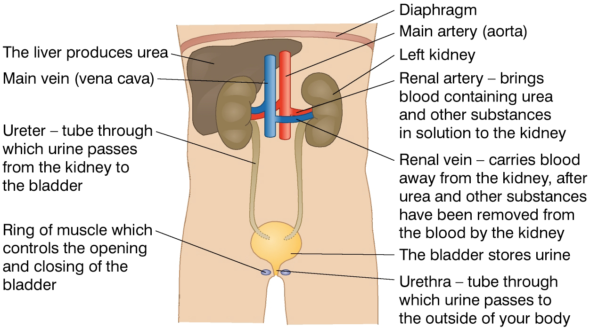
The kidneys

Slide 10
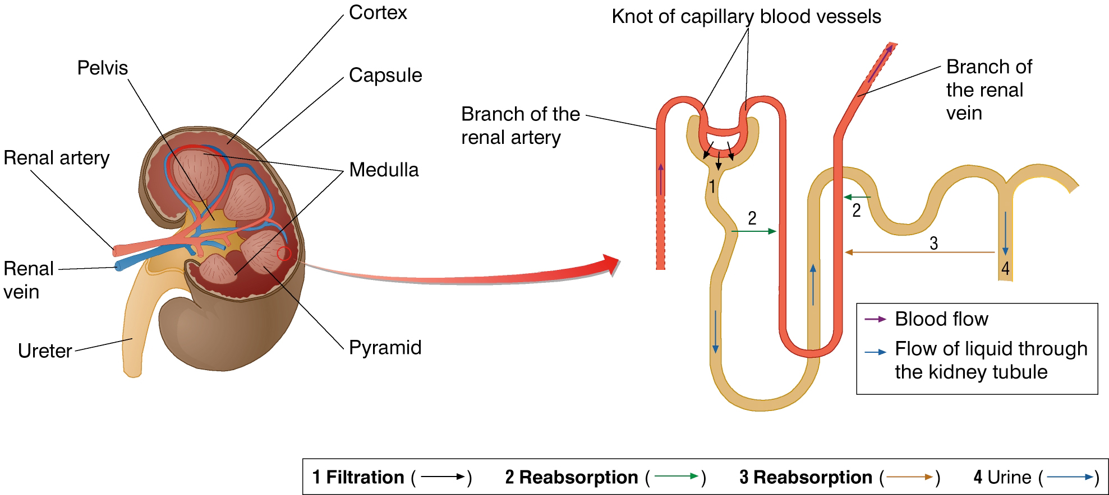
The Kidney

Slide 11
What is urine?
Excretion from the body
Mainly consists of
  UREA
  Excess salt
  Water

Slide 12
The Nephron

Slide 13
Selective reabsorption
Blood enters nephron
Placed under high pressure in the glomerulus
Water and salt reabsorbed back into blood
Remaining liquid moves to bladder through ureter
The amount of water reabsorbed is controlled by ADH

Slide 14
Problems
Too high salt and minerals in diet
  → Solids precipitating out – Kidney stones
Physical assault on kidneys
  → damage to kidney tissue resulting in blood in urine
Too much water
  → Renal failure as kidneys cannot cope with workload

Slide 15
http://news.bbc.co.uk/1/hi/6261509.stm?lsm

Slide 16
Pre/ Post watching
http://www.youtube.com/watch?v=cc8sUv2SuaY
http://www.youtube.com/watch?v=su2wiW1q6OA

Slide 17
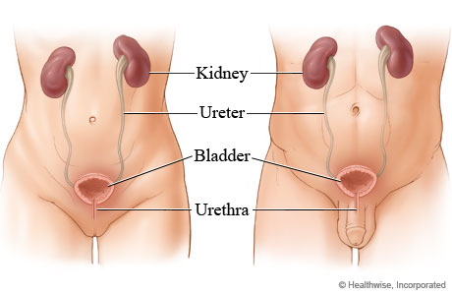
The kidneys X 2

Slide 18
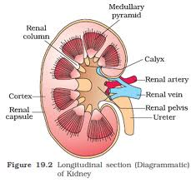
Calyx or Calyses
The kidney is surrounded by a renal capsule and the cortex.
Urine formed in the cortex passes through the minor then major calyx

Slide 19
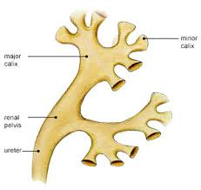
From calyx to renal pelvis
Minor
calyx
Major
calyx
Renal Pelvis
It funnels urine towards the ureter

Slide 20

Renal pelvis
Urine from the calyx then passes into the renal pelvis and continues out down the ureter
Peristalsis moves urine from one structure to the next

Slide 21
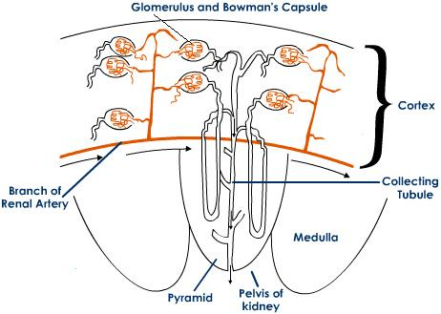
Intro to the finer structure

Slide 22

Ureter and Urethra
Which is which ?
The ureter runs down from the kidney into the bladder and then the urethra from bladder to outside the body, through which we urinate

Slide 23
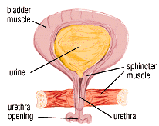
Bladder
Many muscles control the bladder but the main one is the sphincter which release and stop the stream of urine

Slide 24
Ideas for memory recall; renal system
Just suggestions…..
Think of your own

Slide 25
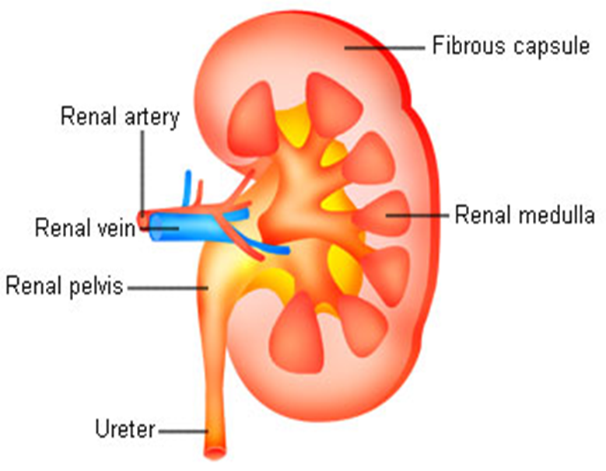
Cortex and medulla
Cortex
Alphabetical order
Cortex = C outer
Medulla = M
Inner and sounds a bit like middle
Medulla

Slide 26
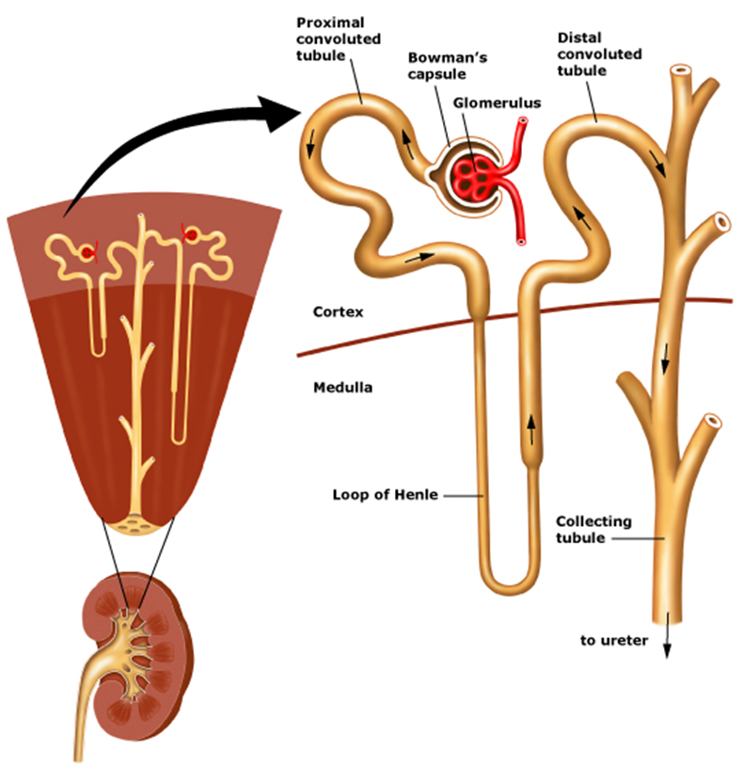
Location
The cortex is where the majority of the nephron is located
Just the loop of Henle drops down into the medulla where there are a lot more blood capillaries.
The collecting duct is taking the urine from the nephrons in the cortex through down to the renal pelvis

Slide 27
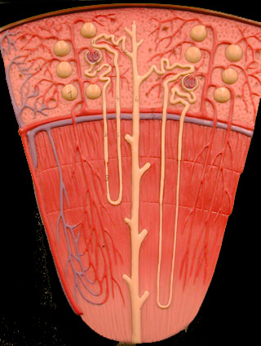
Loop of Henle
The loop of Henle is just that…
…..a loop!
It’s named after Jakob
(Not HENRY) Henle who was a German pathologist

Slide 28
Afferent arteriole
Efferent arteriole
Afferent
Arrival of blood
Efferent
Exit of blood

Slide 29
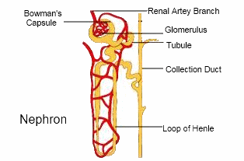
Efferent arteriole
The efferent arteriole goes into the peritubular capillaries that do a BIG job with the absorbing and reabsorbing from the proximal and loop of Henle and the beginning of the distal tubule

Slide 30
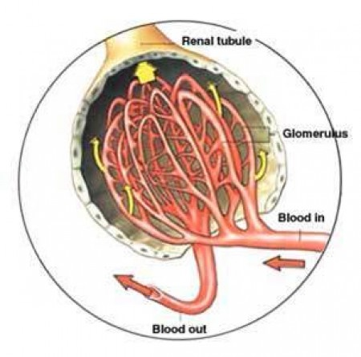
Glomerulus
The glomerulus is the biggest part and the initial start of the nephron….
It “rules” at the beginning
Glomer-“rulus”

Slide 31
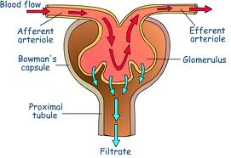
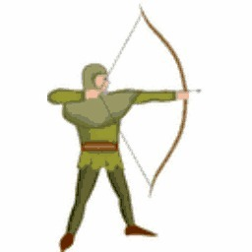
Bowman’s capsule
Named after Sir William Bowman an English surgeon

Slide 32
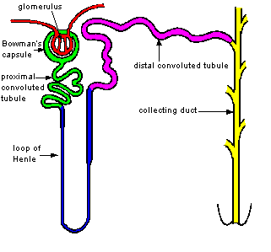
Proximal and distal tubule
The proximal tubule is in closer proximity to the glomerulus
The distal tubule is a further distance
The loop of Henle separates the two

Slide 33

Collecting duct
The thickest tube which carries the urine being filtered out of the kidney through the renal pelvis
It collects the urine

Slide 34
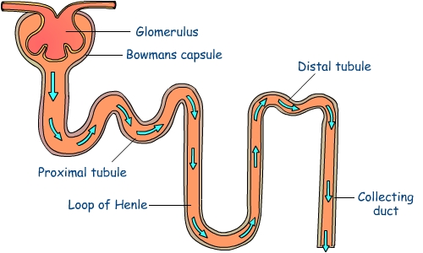
Get it ??

Slide 35
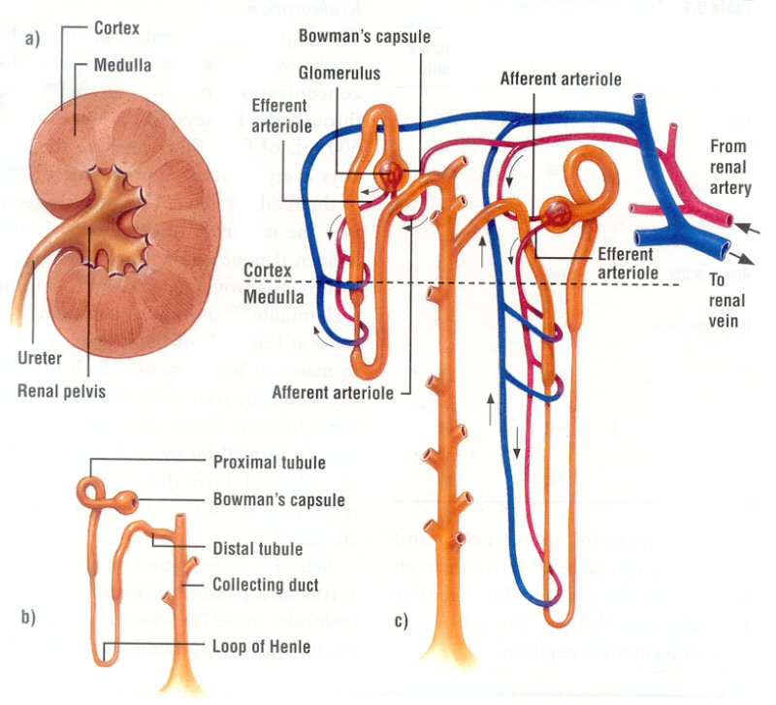
Artery – arrive
Vein - vacate

